Slide 1
HW1 : Low-level Feature Extraction

Slide 2


Part 1 – Gaussian smooth
Gaussian
Gaussian

Slide 3

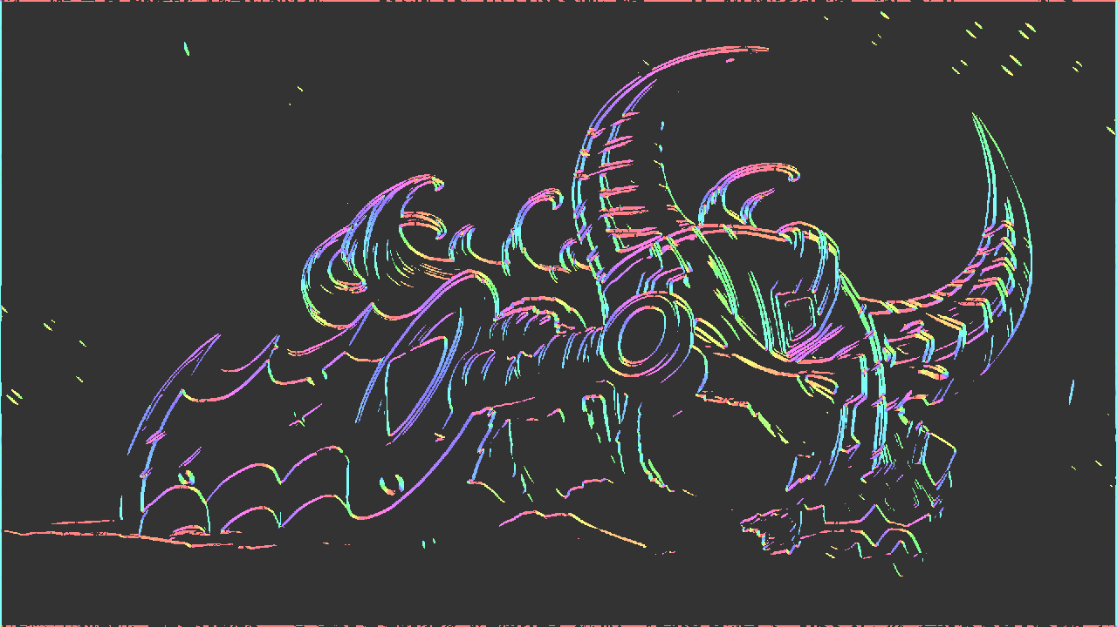
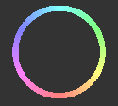

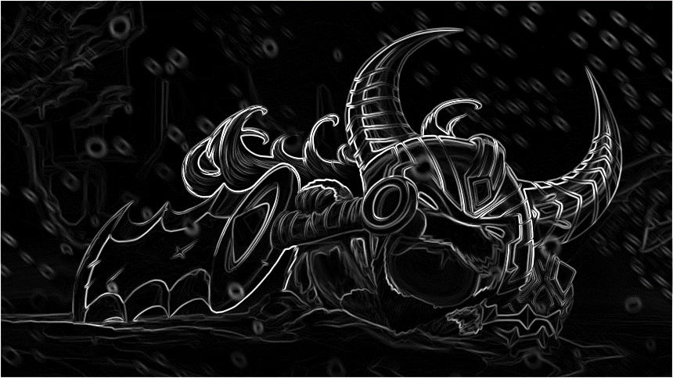
Part 1 – Gradient
rgb2gray
Direction
Magnitude

Slide 4


Part 1 – Non-Maximum Suppression
NMS
Corner Response Function

Slide 5


Part 1 – Comparison
Origin
Rotate
Scale

Slide 6

Part 1 – Comparison

Slide 7
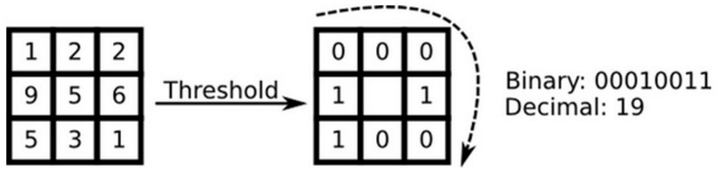
Part 2 – LBP & Uniform LBP
LBP ( dim = 256 )
Uniform LBP ( dim = 59 )
Uniform :
00000000 (0 transitions), 01110000 (2 transitions) and 11001111 (2 transitions)
Non-uniform :
11001001 (4 transitions) and 01010010 (6 transitions)

Slide 8

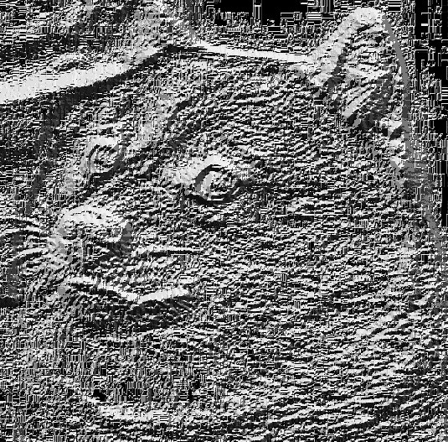
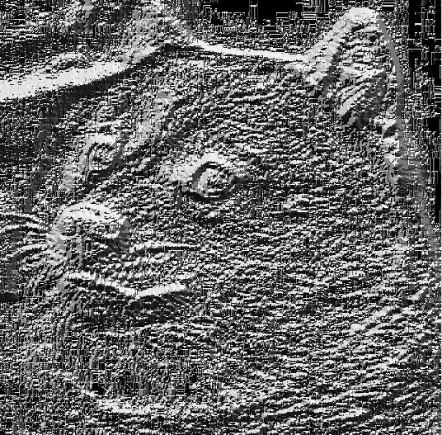
Part 2 – LBP & Uniform LBP
Doge
LBP image
Uniform LBP image

Slide 9
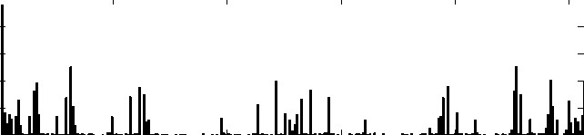
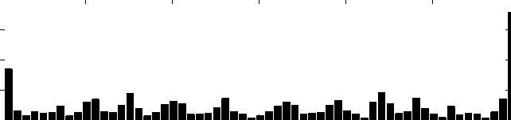
Part 2 – Histogram
Non-uniform (dim:256)
Uniform (dim:59)

Slide 10
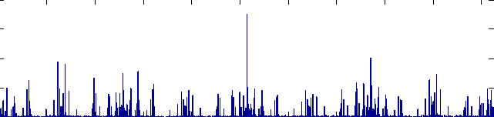
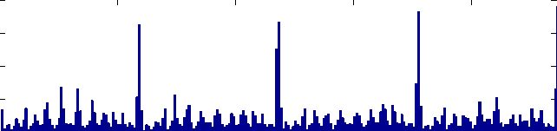
Part 2 – Histogram of 2 x 2 cell
Non-uniform (dim:256 x 4)
Uniform (dim:59 x 4)

